Slide 1
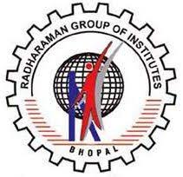
RADHARAMAN AYURVEDIC MEDICAL COLLEGE and RESEARCH HOSPITAL RATIBAD BHOPAL
Subject :- Swastwrutt
Guided by
Dr Paras Nath Paras
( HOD & Professor)
Presented by
Mansi bhanjale
Roll no. 45
BAMS 2nd prof
Batch-2023-24

Slide 2
WATER POLLUTION
INTRODUCTION-
Water pollution is the contamination or degradation of water bodies such as rivers, lakes, ponds, groundwater, and oceans due to the introduction of harmful physical, chemical, or biological substances. These pollutants may originate from industrial discharge, agricultural runoff, sewage waste, domestic garbage, oil spills, plastic waste, and other human activities. When harmful substances enter water, they alter its natural composition, reduce water quality, and make it unsafe for drinking, domestic use, agriculture, aquatic life, and other purposes.Water pollution can occur in different forms, including chemical pollution (like pesticides, heavy metals, and acids), biological pollution (such as bacteria, viruses, and parasites), and physical pollution (like suspended solids and plastics). It disturbs aquatic ecosystems, decreases oxygen levels in water, harms fish and other organisms, spreads water-borne diseases, and affects the overall environmental balance.

Slide 3
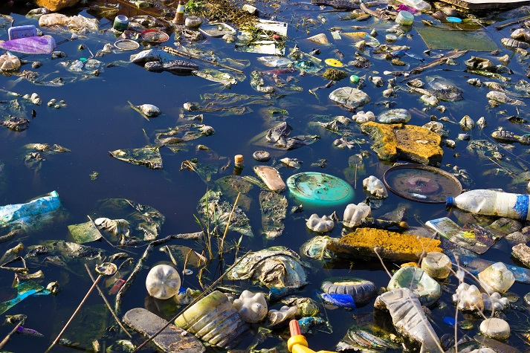
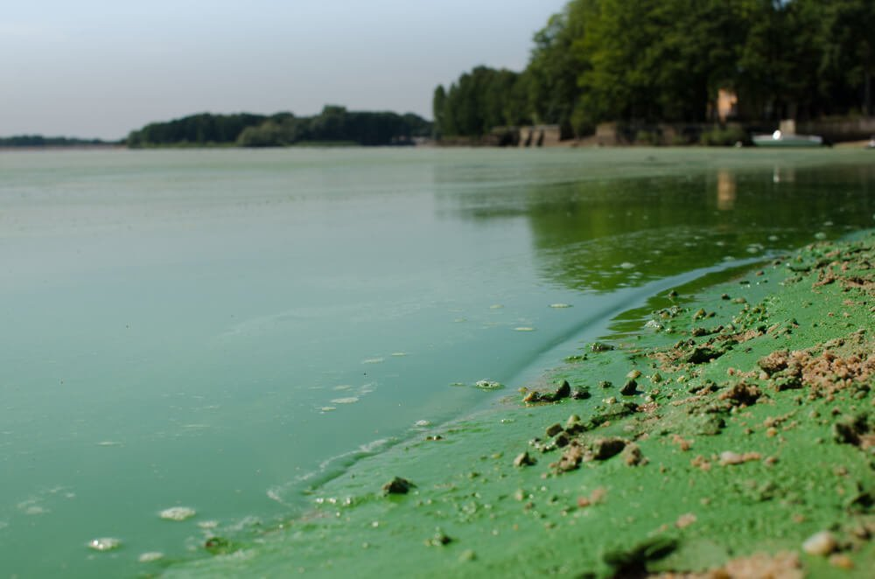
TYPES OF WATER POLLUTION
MAN MADE POLLUTION
NATURAL POLLUTION

Slide 4
MAN MADE WATER POLLUTION
Industrial Discharge -Factories release toxic chemicals, acids, dyes, and heavy metals into nearby water bodies.
Sewage and Wastewater -Untreated domestic sewage from homes and cities contaminates rivers and groundwater.
Agricultural Activities -Use of chemical fertilizers, pesticides, and insecticides leads to runoff into water sources during rainfall.
Oil Spills and Marine Activities -Oil leakage from ships and offshore drilling pollutes oceans.
Plastic and Solid Waste Disposal -Dumping garbage into water bodies harms aquatic life and degrades water quality.

Slide 5
NATURAL WATER POLLUTION
Soil Erosion -Heavy rainfall can wash soil, sand, and minerals into rivers and lakes, making the water muddy (increasing turbidity).
Volcanic Eruptions -Volcanic ash, gases, and minerals can enter nearby water bodies and change their chemical composition.
Decomposition of Plants and Animals -Dead plants and animals decay in water, releasing organic matter and reducing oxygen levels.
Natural Algal Growth (Algal Bloom)-Sometimes algae grow excessively due to natural nutrient availability, reducing oxygen in water.

Slide 6
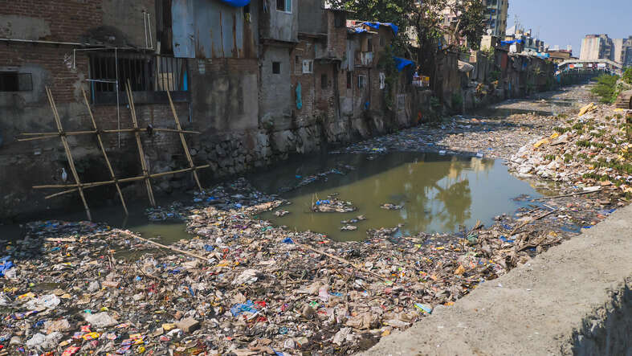
SITUATION IN INDIA
Many Rivers Are Seriously Polluted -A report by the Central Pollution Control Board (CPCB) said that almost half (around 46 %) of India’s rivers are polluted at various stretches due to organic waste, sewage, and industrial effluents
Untreated Sewage and Wastewater Is a Big Problem -In India, a large amount of sewage and wastewater enters water bodies without proper treatment, carrying harmful bacteria and pollutants.
Groundwater Pollution Is Widespread -In many regions, groundwater is contaminated with chemicals like arsenic, fluoride, nitrate, and heavy metals due to agricultural runoff, industrial discharge, and poor sanitation
Health and Environmental Consequences -Polluted water exposes millions of people to waterborne diseases, especially in rural and urban poor communities.

Slide 7
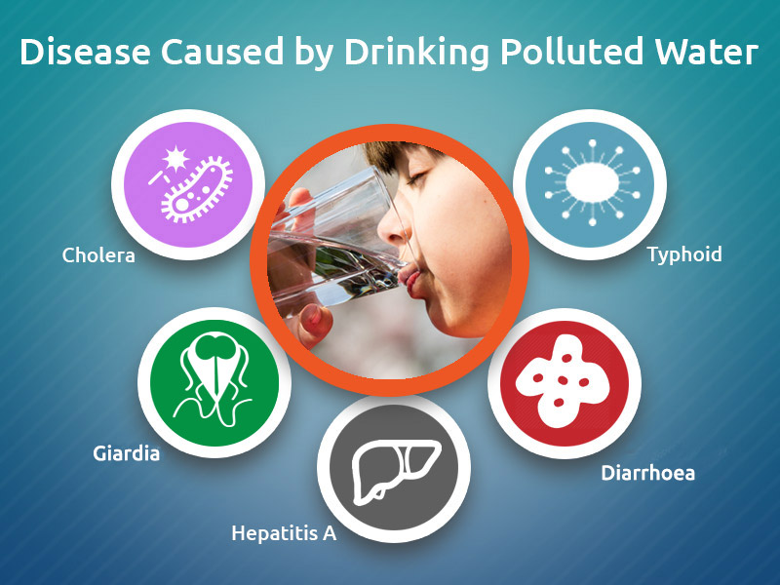
HEATH HAZARDS
Water pollution causes serious health problems when contaminated water is used for drinking, cooking, bathing, or irrigation. The harmful effects can be short-term or long-term.
TYPES
BIOLOGICAL
CHEMICAL

Slide 8
(BIOLOGICAL) WATER –BORNE DISEASES
Polluted water contains bacteria, viruses, and parasites that cause:
Cholera
Typhoid
Dysentery
Hepatitis A
Diarrhea
These diseases spread mainly through drinking contaminated water.

Slide 9
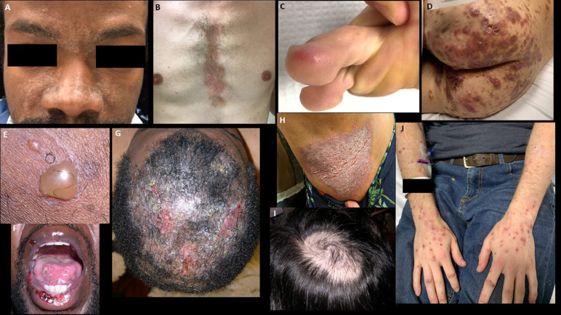
SKIN AND EYE PROBLEMS
Bathing or washing in polluted water may cause:
Skin rashes
Allergies
Eye irritation

Slide 10
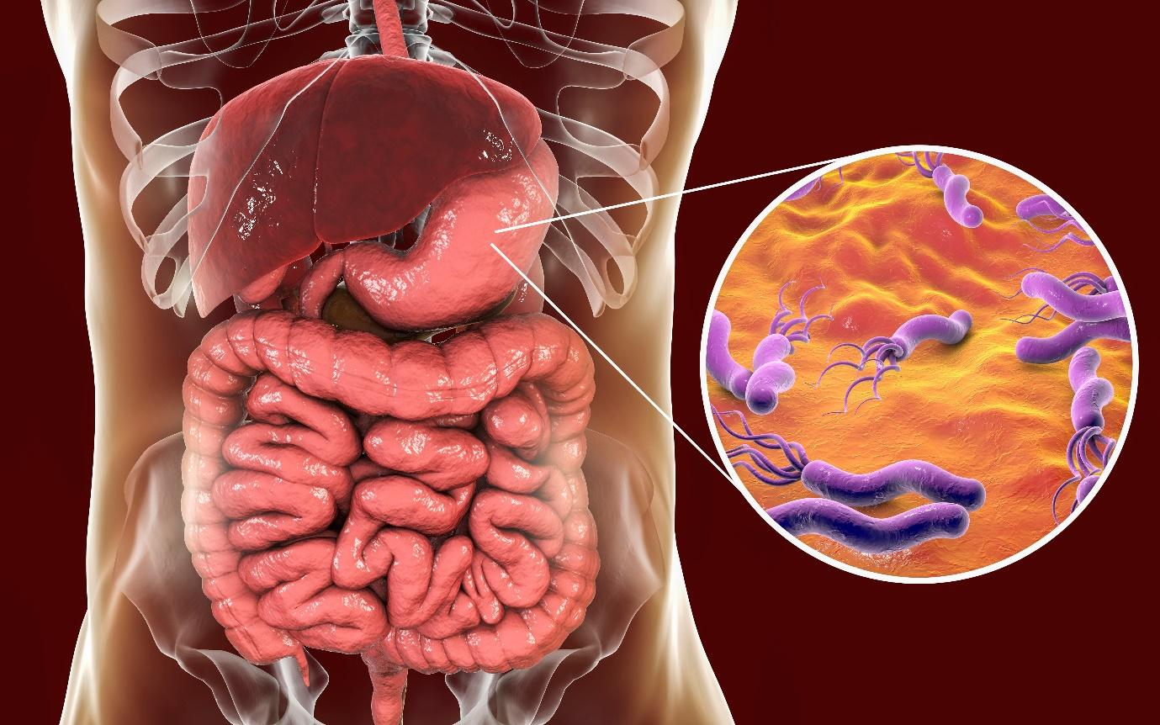
GASTROINTESTINAL PROBLEMS
Contaminated water can cause:
Vomiting
Stomach Pain
Indigestion

Slide 11
LONG-TERM DISEASES
Continuous use of polluted water may lead to:
Cancer (due to toxic chemicals)
Fluorosis (excess fluoride)
Arsenicosis (arsenic contamination)
Weak immune system

Slide 12
(CHEMICAL)
Industrial waste and agricultural chemicals mix with water and cause:
Heavy metal poisoning (lead, mercury, arsenic)
Nerve damage
Kidney and liver problems
Developmental problems in children

Slide 13
In addition to the above, water is associated with the following:
Dental health: The presence of fluoride at about 1 mg/litre in drinking water is known to protect against dental caries, but high levels of fluoride cause mottling of the dental enamel
Cyanosis in infant: High nitrate content of water is associated with methemoglobinemia.
Cardiovascular diseases: Hardness of water is beneficial for cardiovascular diseases.
Some diseases are transmitted due to inadequate use of water like shigellosis, trachoma and conjunctivitis, ascariasis, scabies.

Slide 14
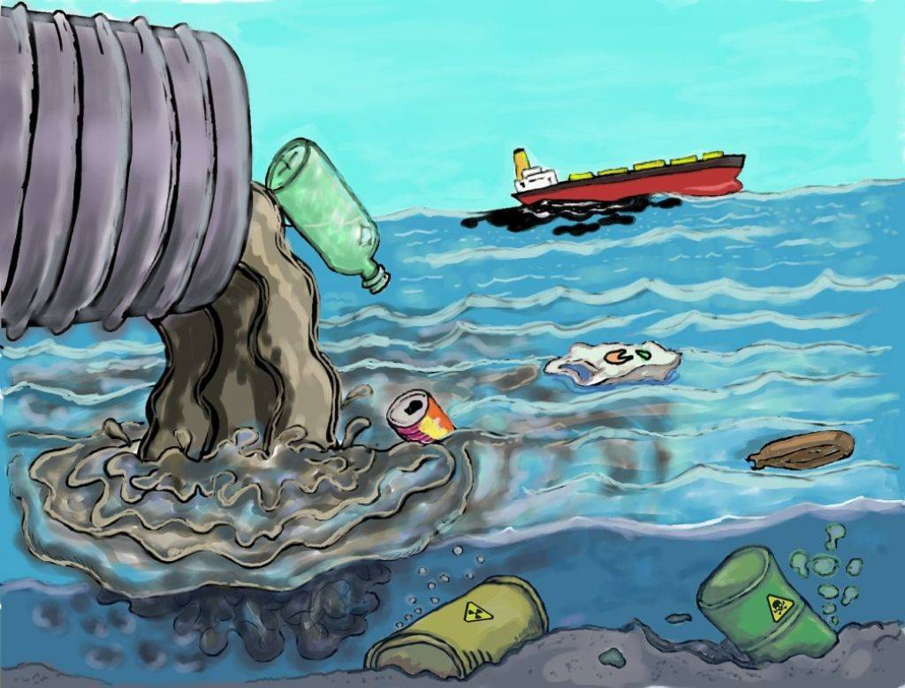
WATER POLLUTION LAW
The Water (Prevention and Control of Pollution) Act1974 seeks to provide legal deterrent against the spread of water pollutioN

Slide 15
PREVNTION AND CONTROL MEASURES
Treatment of Sewage – Treat domestic wastewater in sewage treatment plants before discharge.I
ndustrial Effluent Treatment – Industries must treat waste in Effluent Treatment Plants (ETPs) before releasing into rivers.
Proper Solid Waste Disposal – Avoid dumping garbage and plastics into water bodies.
Reduce Use of Chemical Fertilizers and Pesticides – Promote organic farming to prevent agricultural runoff.

Slide 16
CONCLUSION
Prevention and control of water pollution require combined efforts from the government, industries, and individuals. Proper waste treatment, reduced chemical use, awareness, and strict law enforcement are key to protecting water resources
The effects of water pollution include the spread of waterborne diseases, damage to ecosystems, loss of biodiversity, and long-term health problems in humans. If not controlled, it can lead to scarcity of clean and safe water for future generations.

Slide 17
THANKYOU

